Slide 1
The Forward Model Code Overview and How To
created: 30.06.2020, Franziska Riegger
modified: 21.07.2020, Franziska Riegger

Slide 2
Outline
Software Overview
The Classes
Simulation class
SpaceInterferometer class
Waveform class
Noise class
InterSCDopplerObservable class
TDI class
Tests

Slide 3
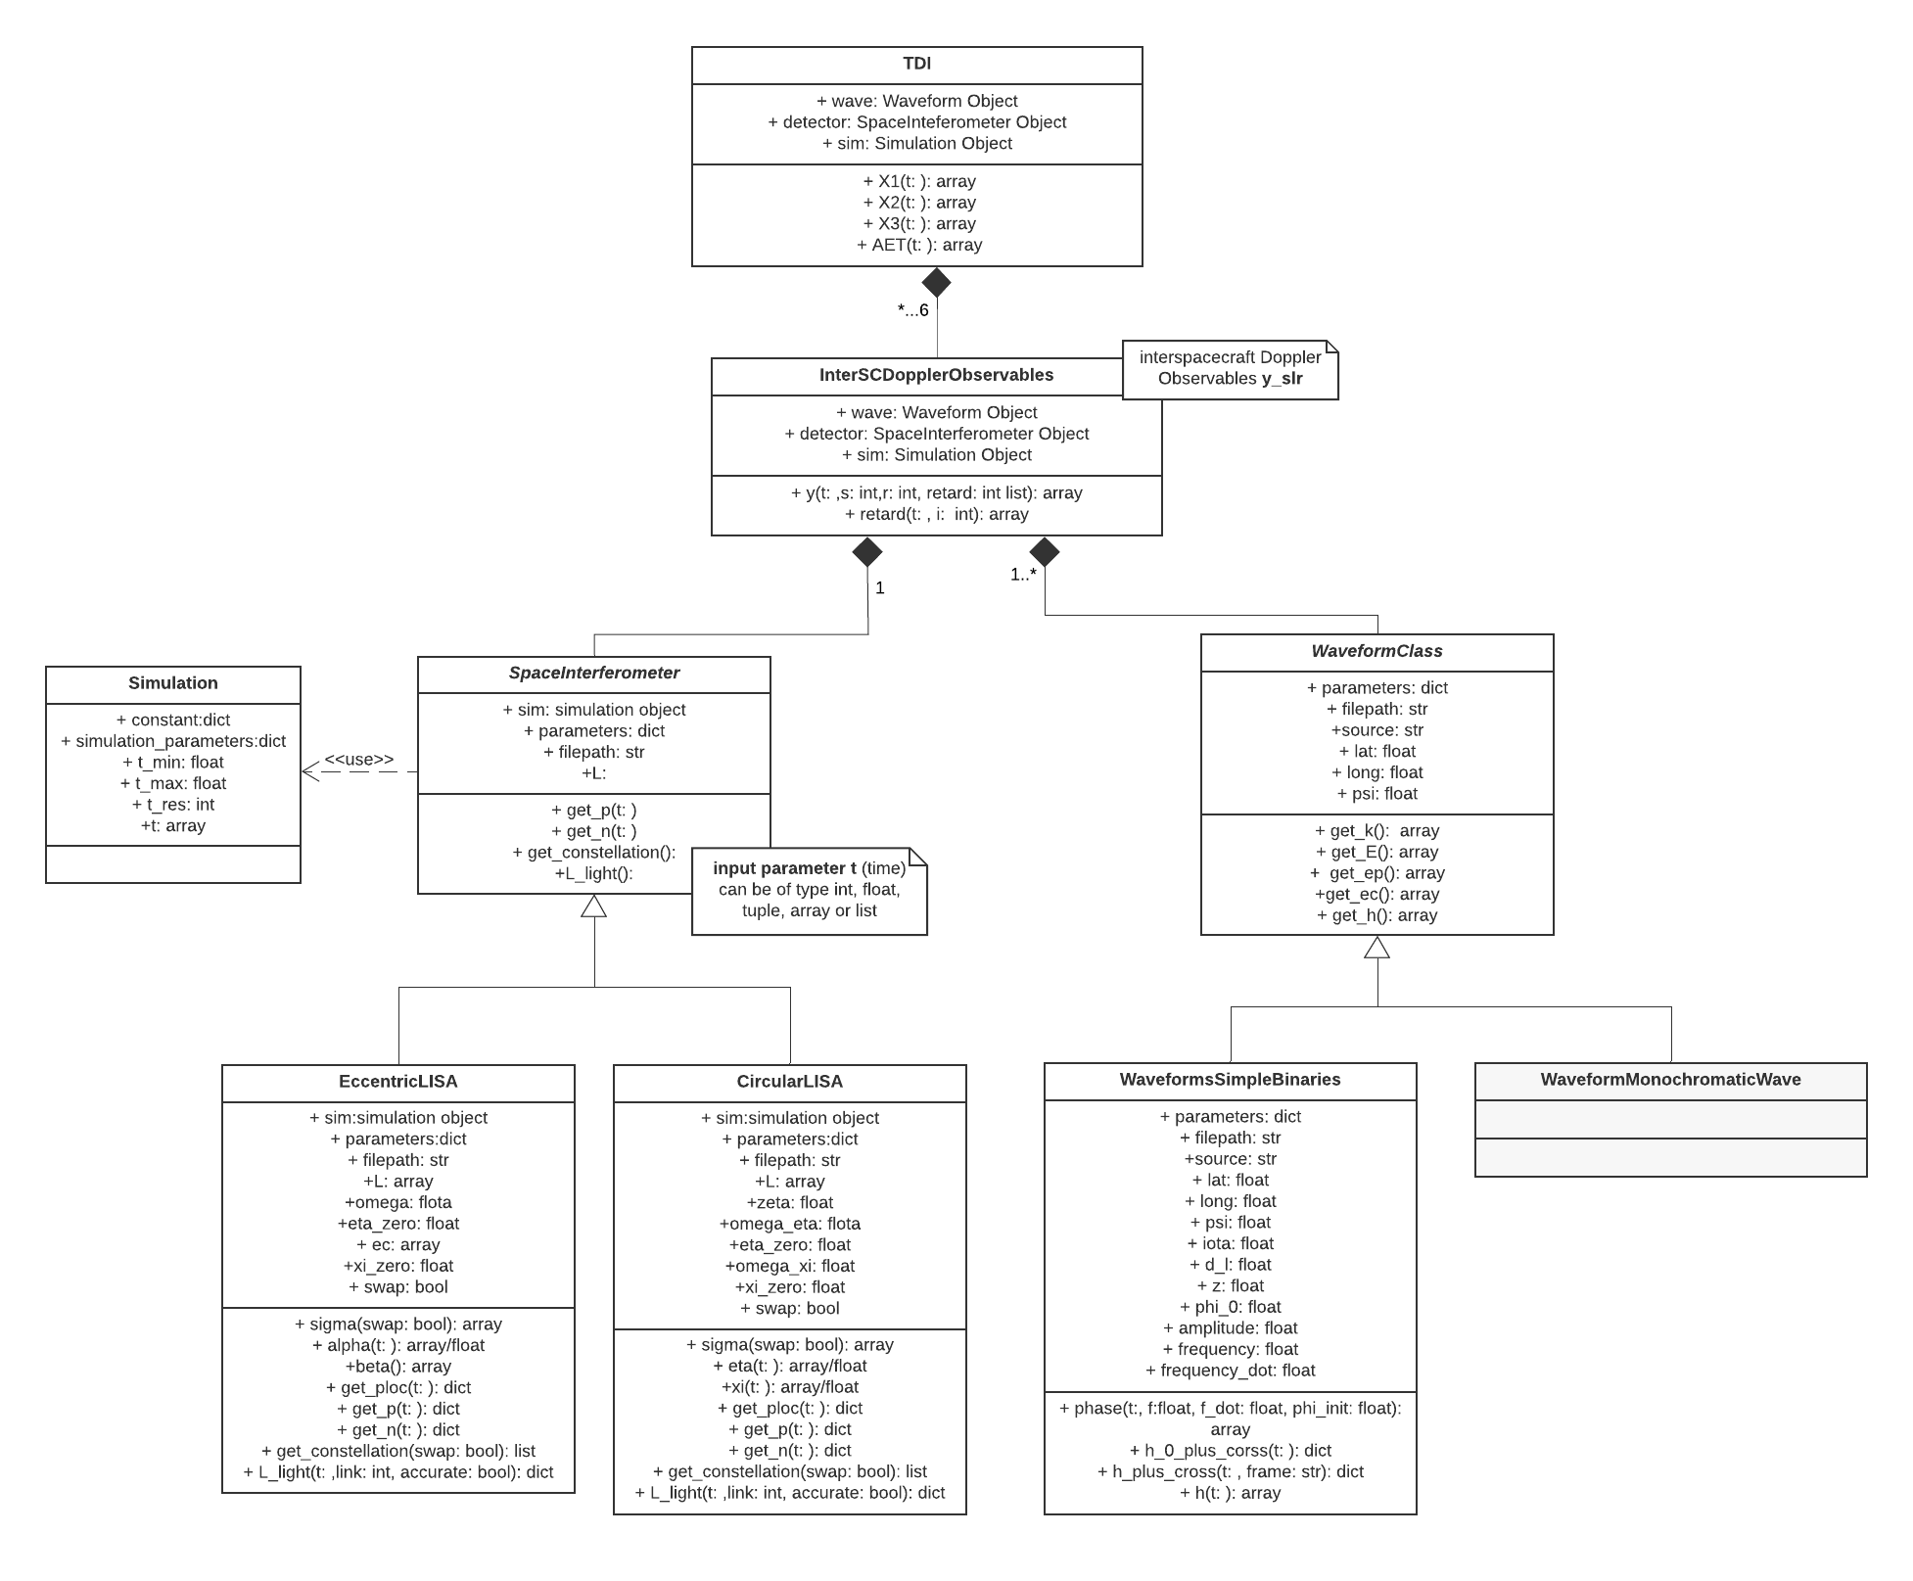
Software Overview
UML Class Diagram

Slide 4
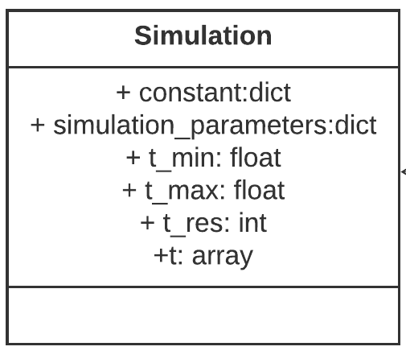
The Classes
Simulation Class
Sets general constants and simulation parameters

Slide 5
The Classes
SpaceInterferometer Class
Abstract class (interpreted as “empty template”) which defines the key attributes and methods that every LISA object has to define

Slide 6
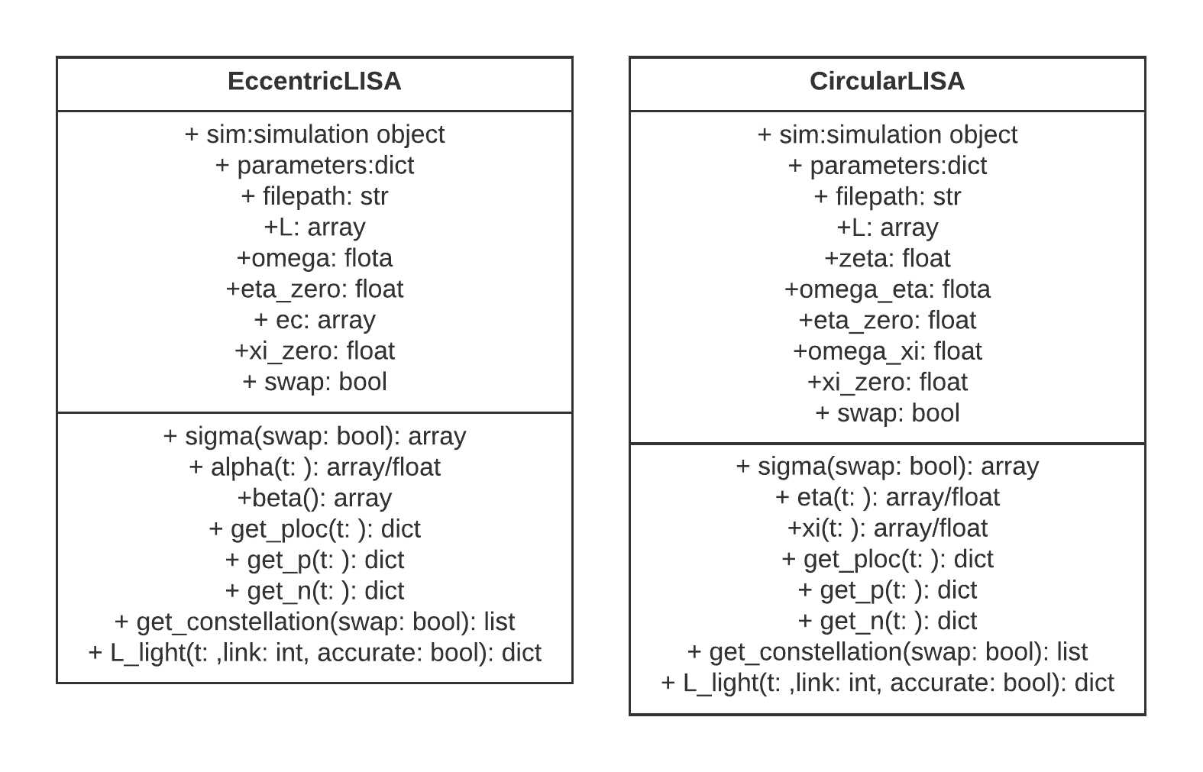
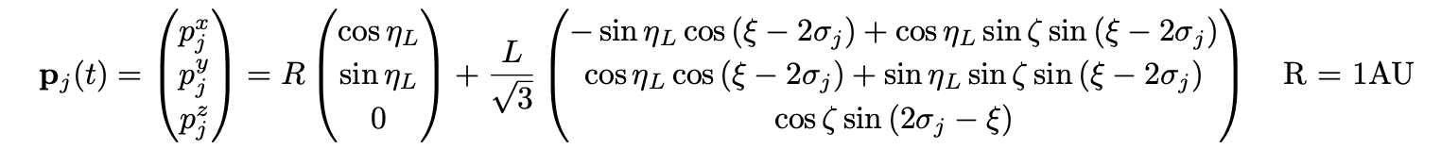
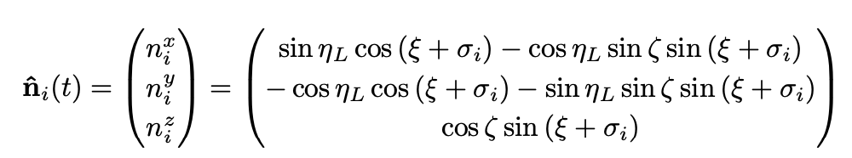
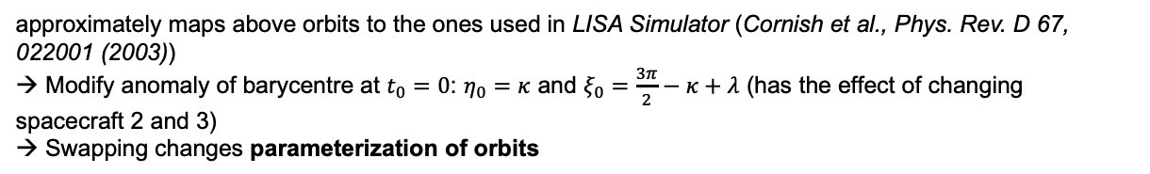
The Classes
SpaceInterferometer Realization: CircularLISA
CircularLISA
rigid LISA array with equal and constant arms
→ based on Krolak et al., PRD 70, 022003 (2004)
The orbits
Circular, with $η_{L}\left(t\right)=Ωt+η_{0}, ξ\left(t\right)=−Ωt+ξ_{0}$ and $σ_{j}=\frac{3π}{2}−\frac{2\left(j−1\right)π}{3}$
Light propagation direction
Light propagation time
co- and counterrotating armlengths:
Swap Option
approximately maps above orbits to the ones used in LISA Simulator (Cornish et al., Phys. Rev. D 67, 022001 (2003))
→ Modify anomaly of barycentre at $t_{0}=0$: $η_{0}=κ$ and $ξ_{0}=\frac{3π}{2}−κ+λ$ (has the effect of changing spacecraft 2 and 3)
→ Swapping changes parameterization of orbits

Slide 7
The Classes
SpaceInterferometer Class Realizations: CircularLISA

Slide 8
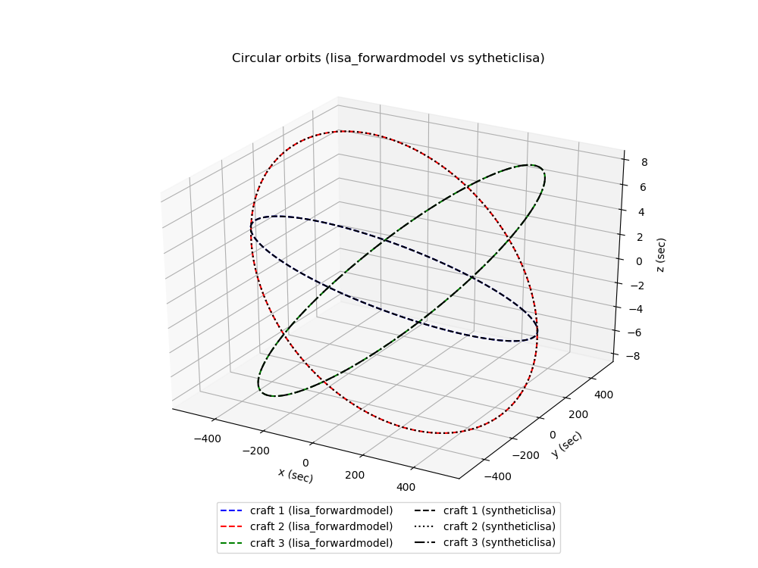
The Classes
SpaceInterferometer Class Realizations: CircularLISA
Comparison SyntheticLISA – Forward Model

Slide 9
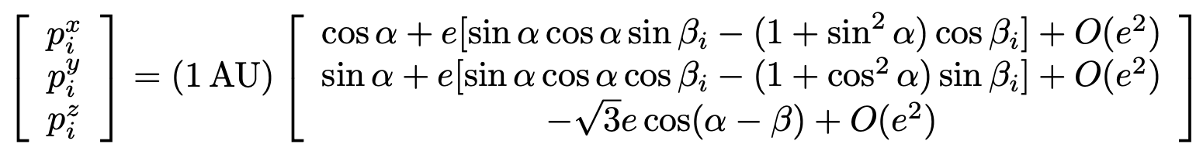
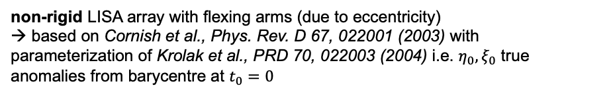
The Classes
SpaceInterferometer Realizations: EccentricLISA
EccentricLISA
non-rigid LISA array with flexing arms (due to eccentricity)
→ based on Cornish et al., Phys. Rev. D 67, 022001 (2003) with parameterization of Krolak et al., PRD 70, 022003 (2004) i.e. $η_{0},ξ_{0}$ true anomalies from barycentre at $t_{0}=0$
The orbits
Eccentric (realistic Keplerian), with $α=Ωt+η_{0}, β_{i}=η_{0}+ξ_{0}−σ_{i}$ and $e=L/2\sqrt{3}R$
Light propagation direction
Computed by ${\hat{n}}_{i}\left(t\right)=(p_{s}\left(t\right)−p_{r}\left(t\right))/|p_{s}\left(t\right)−p_{r}\left(t\right)|$
Light propagation time
co- and counterrotating arms and flexing due to eccentricity; with $δ_{i}=\left\{ξ_{0},ξ_{0}+\frac{4π}{3},ξ_{0}+2π/3\right\}$
Swap Option
see CircularLISA

Slide 10
The Classes
Class | EccentricLISA
Realization | SpaceInterferometer
Minimal input | parameters either via parameters of filepath
Attributes | Name | Type | Units | Default |  | Specification
 | L | 3D array | m | from self.parameters |  | lengths of LISA arms
 | swap | bool | -- |  |  | swaps between two different ways to define initial position and order of spacecraft labeling
 | omega | float | rad/year |  |  | angular velocity of LISA baricenter around Sun
 | eta_zero | float | rad |  |  | initial position of rotation around Sun
 | xi_zero | float | rad |  |  | initial position of rotation around baricenter
 | ecc | float | -- | L/2sqrt(3)R |  | eccentricity of orbits
Method | Name | Specification | Input |  |  |  | Output
 |  |  | Name | Specification | Type | Default | Type
 | sigma | angular position of spacecrafts wrt baricenter | swap | notational settnig | bool | self.swap | sigam: 3D array
 | alpha | rotation around sun | t | time of evaluation | int/float/list /tuple/array | self.sim.t | eta:(dim(t))D array
 | beta | positional parameter, encoding anomaly wrt barycentre at t=0 | -- |  |  |  | beta: 3D array
 | get_ploc | positions of spacecrafts wrt to LISA baricenter | t | time of evaluation | int/float/list /tuple/array | self.sim.t | ploc: dict() e.g. ploc['1']: (dim(t),3)D array
 |  |  | approx | order of accuracy in model | int | 2
 | get_p | returns positoin of spacecrafts wrt Sun | t | time of evaluation | int/float/list /tuple/array | self.sim.t | p: dict() e.g. p['1']: (dim(t),3)D array
 |  |  | approx | order of accuracy in model | int | 2
 | get_n | returns light propagation directions | t | time of evaluation | int/float/list /tuple/array | self.sim.t | n: dict() e.g. n['1']: (dim(t),3)D array
 | get_constellation | constellations for measurements | swap | notational settnig | bool | self.swap | list with entries [sending, transmitting, receiving] spacecraft indices
 | L_light | travel times in seconds that laser beams experience between two spacecrafts | t | time of evaluation | int/float/list /tuple/array | self.sim.t | L_light: dict() e.g. L['-1']: (dim(t))D array
 |  |  | link | link along which laser is transmitted | int/str | all possible links
 |  |  | accurate | sets propagation direction dependency is considered | bool | True
SpaceInterferometer Realizations: EccentricLISA

Slide 11
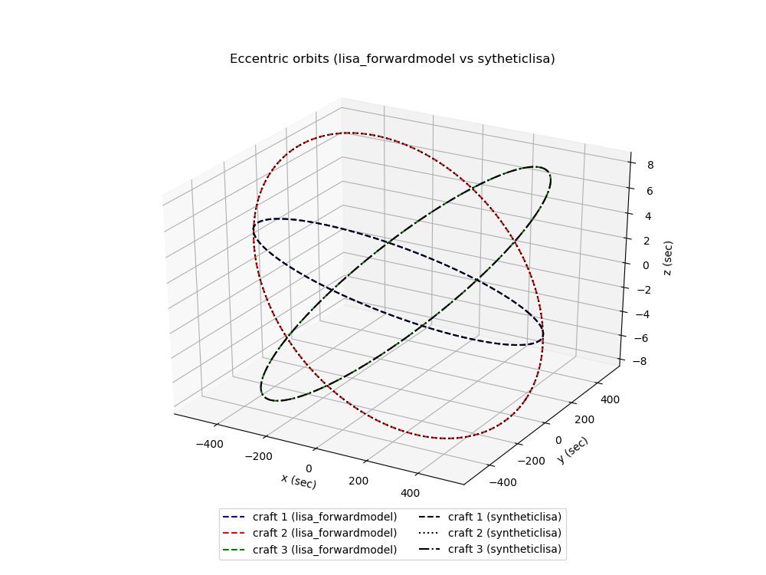
The Classes
SpaceInterferometer Realizations: EccentricLISA
Comparison SyntheticLISA – Forward Model

Slide 12
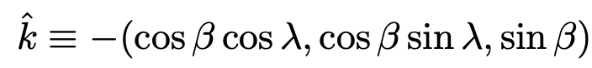
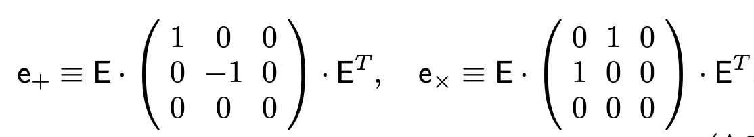
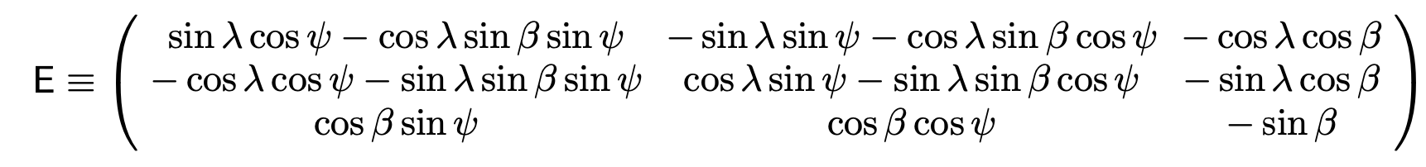
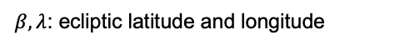
The Classes
Waveform Class
WaveformClass
defines methods for geometrical setup that every Waveform realization is sharing
→ based on Krolak et al., PRD 70, 022003 (2004)
The metric perturbation
with $h_{+}\left(t\right),h_{×}\left(t\right)$ the plus and cross polarization components of wave at time $t$, metric perturbation at origin of SSB frame is
where $\hat{k}$ is the wave unit propagation direction, defined as
$β,λ$: ecliptic latitude and longitude
Polarization tensors
with Euler rotation sequences
Polarization Components
derived classes have to deliver methods for $h_{+}$ and $h_{×}$

Slide 13
The Classes
Waveform Class
Abstract class (interpreted as “empty template”) which defines the key attributes and methods that every waveform object has to define

Slide 14
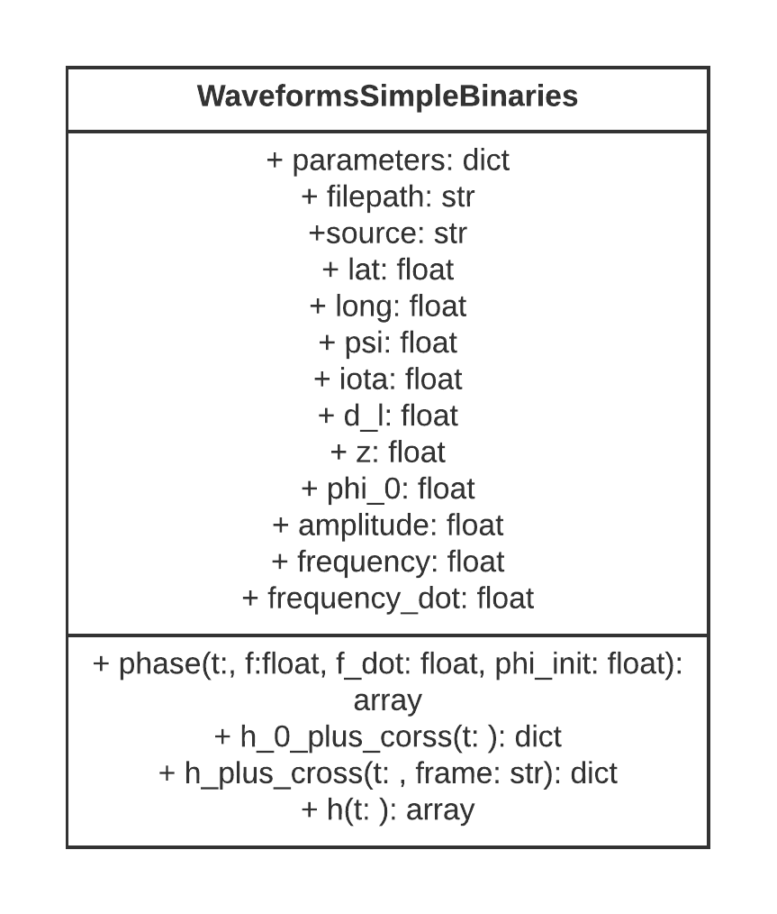
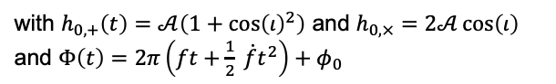
The Classes
Waveform Realization: WaveformSimpleBinaries
WaveformSimpleBinaries
defines methods for polarization components of Simple Galactic Binary
The polarization components
with $h_{0,+}\left(t\right)=𝒜\left(1+\cos{{\left(ι\right)}^{2}}\right)$ and $h_{0,×}=2𝒜\cos\left(ι\right)$
and $Φ\left(t\right)=2π\left(ft+\frac{1}{2} \dot{f}t^{2}\right)+φ_{0}$

Slide 15
The Classes
Waveform Realization: WaveformSimpleBinaries

Slide 16
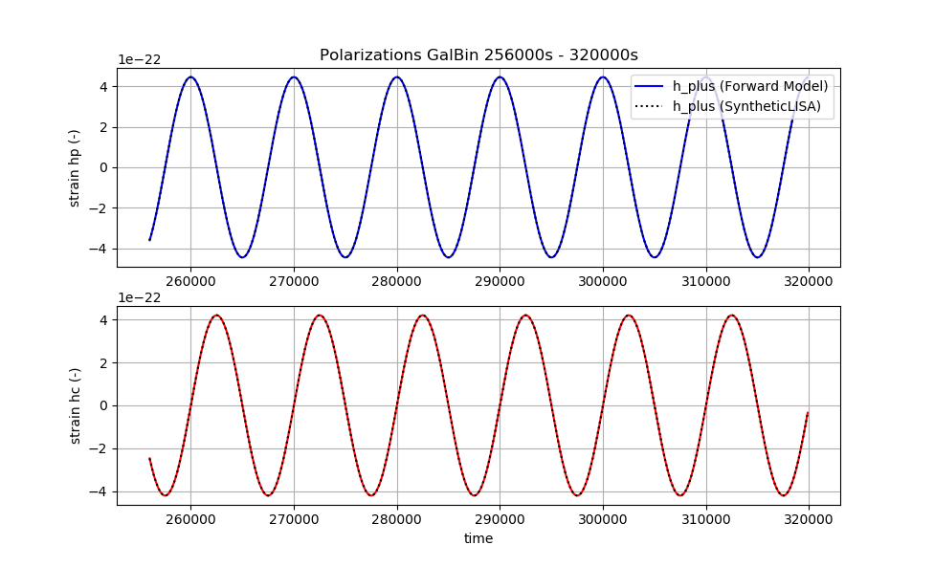
The Classes
Waveform Realization: WaveformSimpleBinaries
Comparison SyntheticLISA – Forward Model

Slide 17
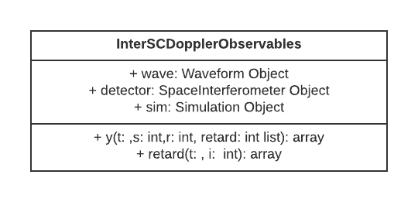
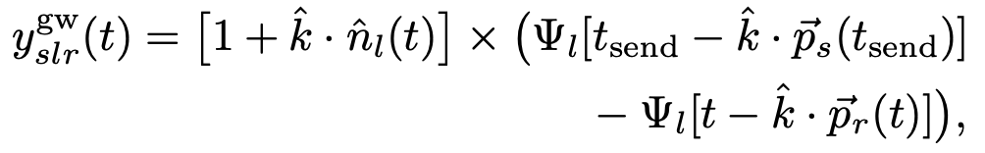
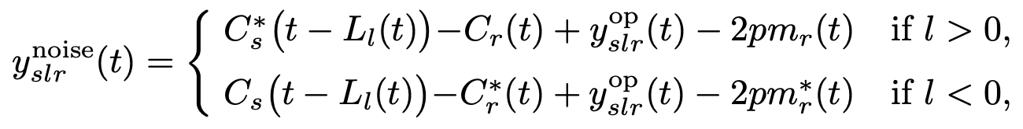
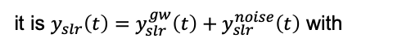
The Classes
InterSCDopplerObservables
InterSCDopplerObservables
defines methods for basic Doppler responses y between spacecrafts
Basic Doppler Responses
it is $y_{slr}\left(t\right)=y_{slr}^{gw}\left(t\right)+y_{slr}^{noise}\left(t\right)$ with
and
BUT: simulation does not consider noise, i.e. the Doppler Responses reduces to $y_{slr}\left(t\right)=y_{slr}^{gw}\left(t\right)$

Slide 18
The Classes
InterSCDopplerObservables

Slide 19
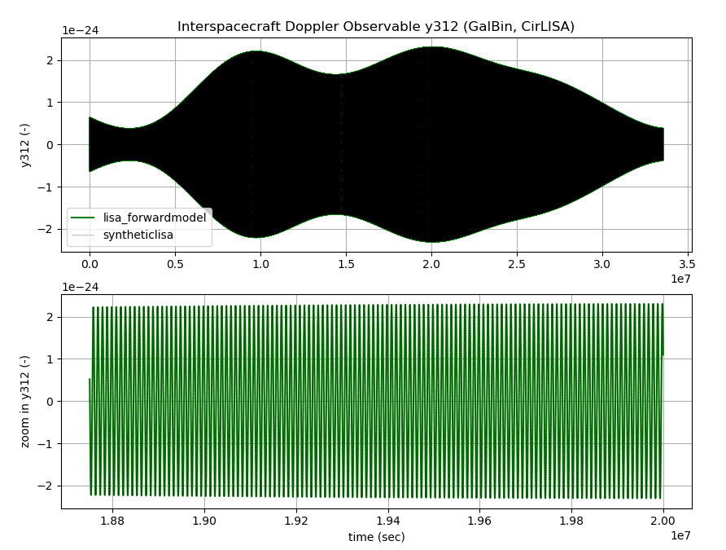
The Classes
InterSCDopplerObservables
Comparison SyntheticLISA – Forward Model

Slide 20
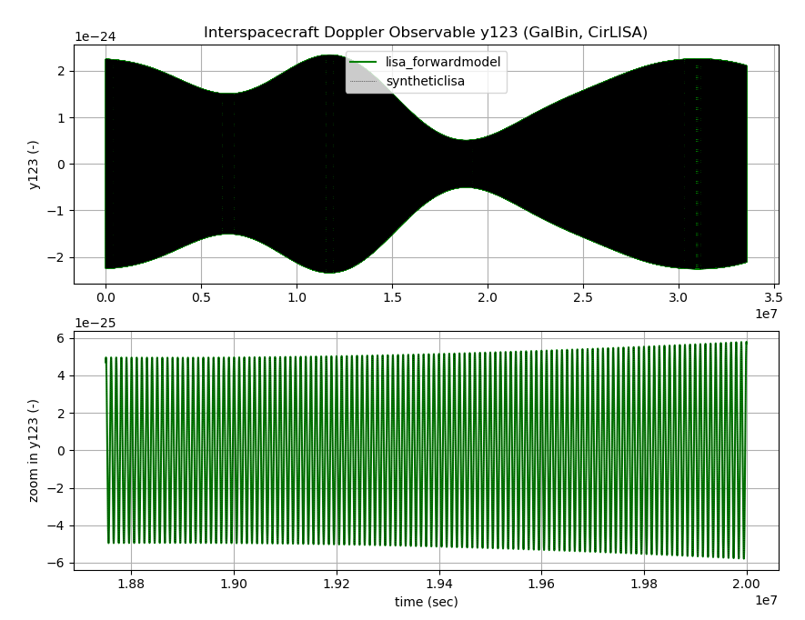
The Classes
InterSCDopplerObservables
Comparison SyntheticLISA – Forward Model

Slide 21
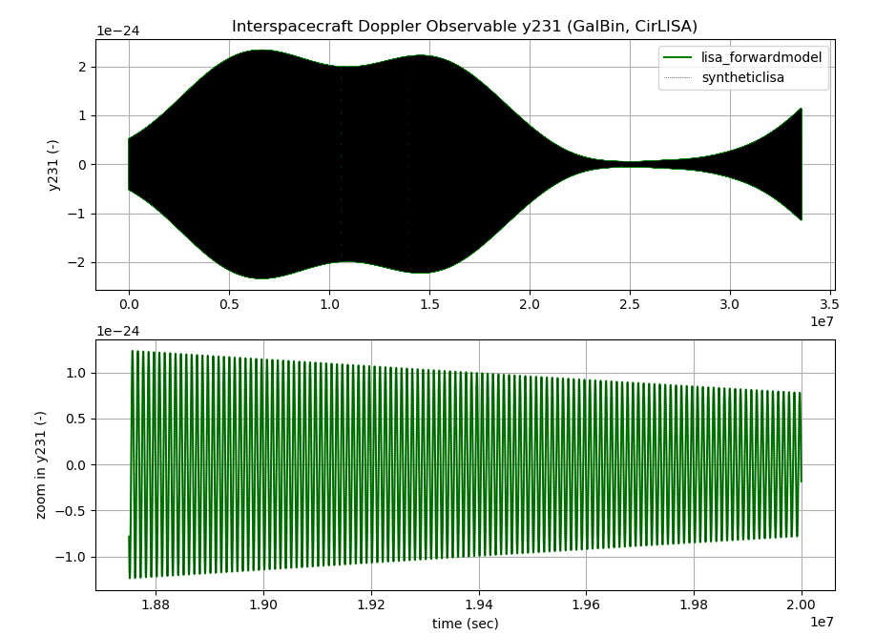
The Classes
InterSCDopplerObservables
Comparison SyntheticLISA – Forward Model

Slide 22
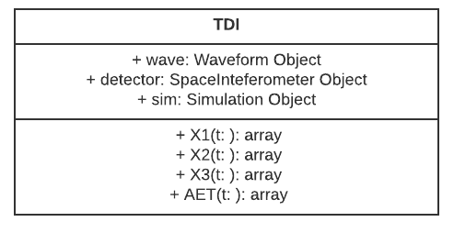
The Classes
TDI Class

Slide 23
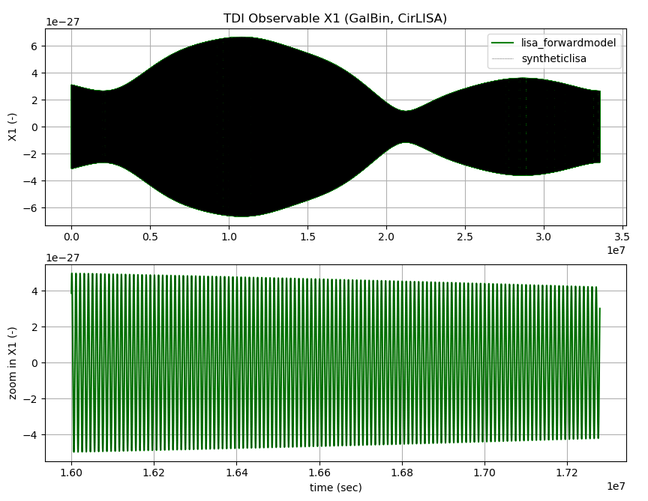
The Classes
The TDI Class
Comparison SyntheticLISA – Forward Model

Slide 24
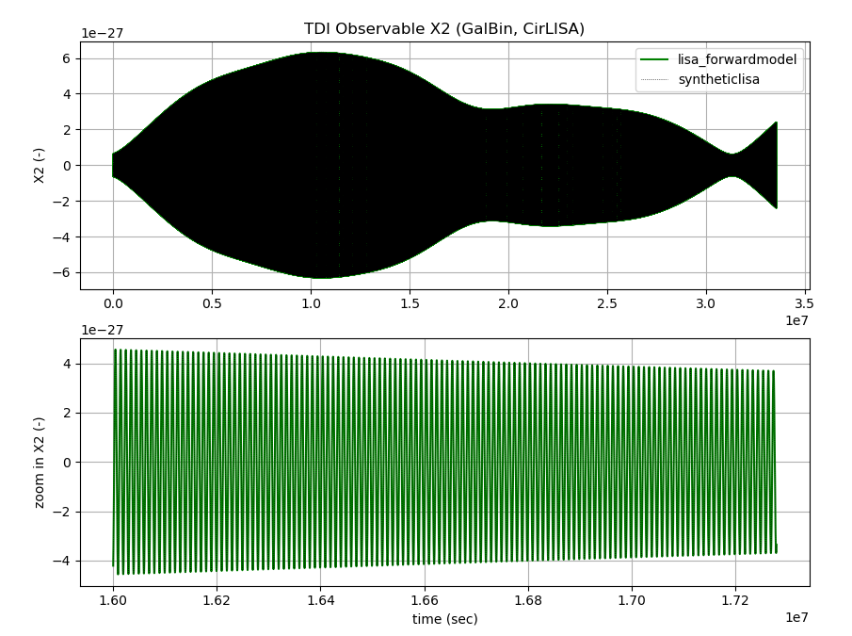
The Classes
The TDI Class
Comparison SyntheticLISA – Forward Model

Slide 25
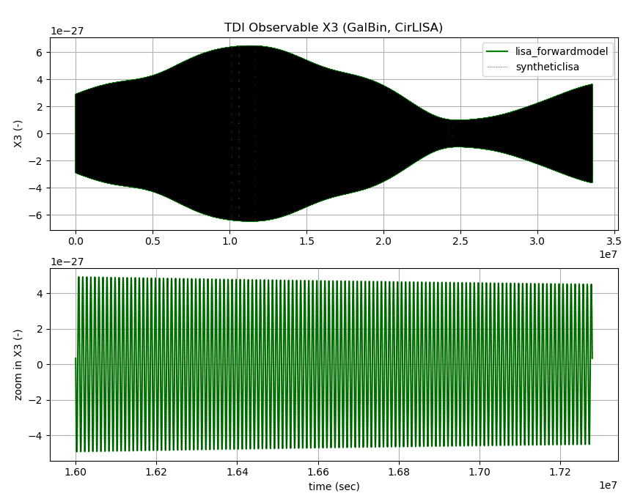
The Classes
The TDI Class
Comparison SyntheticLISA – Forward Model

Slide 26
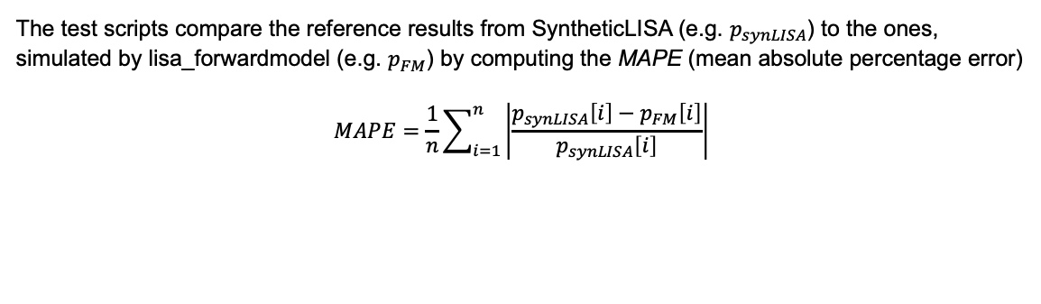
The Tests
Overview
Error measure
The test scripts compare the reference results from SyntheticLISA (e.g. $p_{synLISA}$) to the ones, simulated by lisa_forwardmodel (e.g. $p_{FM}$) by computing the MAPE (mean absolute percentage error)
$$MAPE=\frac{1}{n}\sum_{i=1}^{n}{\left|\frac{p_{synLISA}\left[i\right]−p_{FM}\left[i\right]}{p_{synLISA}\left[i\right]}\right|}$$

